Slide 1
DSP project
Signal Analyzer app
By Ashfaq Ahmad (19pwcse1795)
Amir suleman (19pwcse1805)

Slide 2
Signal Analyzer
it is signal processing toolbox used to visualizing, analyzing and comparing different signal .
By using this tool we can represent a signal in three domain.
Time Domain
Frequency domain.
Time Frequency domain

Slide 3
Steps Involved In Analyzing A Signal
Select a signal to analyzer
Preprocess a signal
Explore the signal
Share analysis

Slide 4
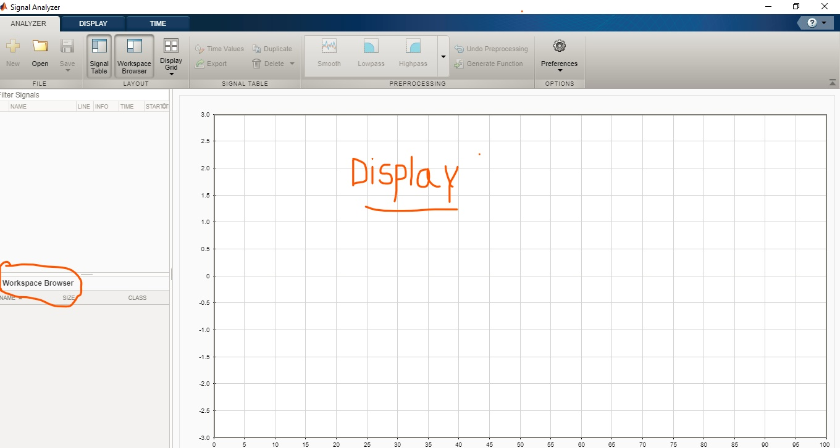
Select signal to Analyzer
From the Workspace browser by clicking their names and dragging them to the Signal table.
To plot a signal, drag it to a display.
also drag signals directly from the Workspace browser to a display.
modify a signal in the MATLAB workspace, the Workspace browser updates automatically.
Analyzer recognize until reimport

Slide 5
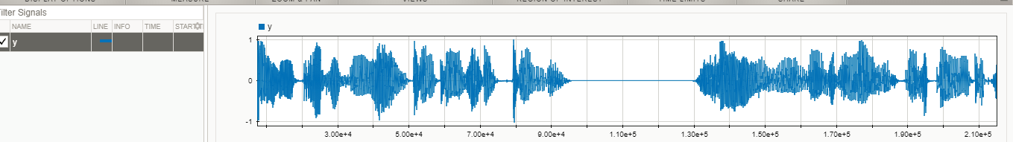
Time Domain

Slide 6
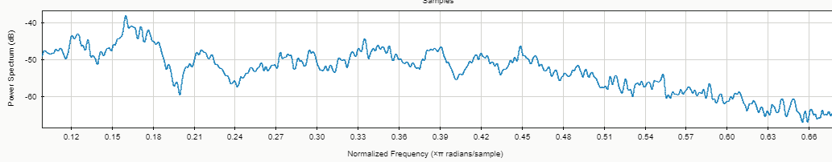
Frequency Domain

Slide 7
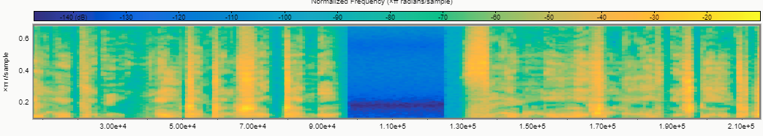
Frequency Time Domain

Slide 8
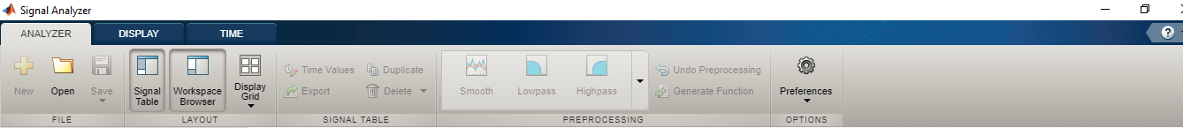
Preprocess the Signal
Different preprocessing options appear in the analyzer tab.
preprocessing operations, undo operations, edit actions, and function generation apply to all signals currently selected in the signal table.
preprocessing steps can be undone by clicking undo preprocessing on the analyzer tab

Slide 9
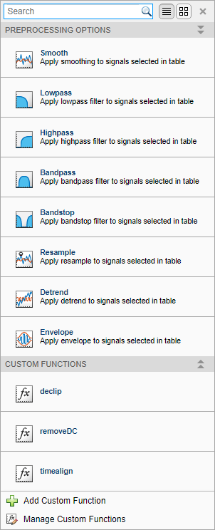
Cont.
Preprocessing Gallery:

Slide 10
Cont.
Edit Signals
in edit tap we can perform a trim or clip action, draw a crosshair on the plot at the location where you want to remove data.
Filter Signals
on analyzer tabclick the lowpass, highpass, bandpass, or bandstop icon in the preprocessing gallery.

Slide 11
CONT.
Resample Signals
On the analyzer tab, expand the preprocessing gallery and click the resample icon
function resample to perform the resampling.
Denoise Signals
on the analyzer tab, expand the preprocessing gallery and click the denoise icon.
signal analyzer uses the wdenoise.

Slide 12
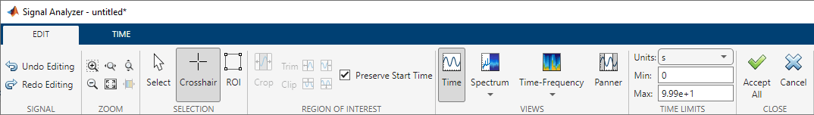
Cont.
Editing steps can be undone by clicking undo editing on the edit tab.
To duplicate a signal, use the duplicate button on the analyzer tab

Slide 13
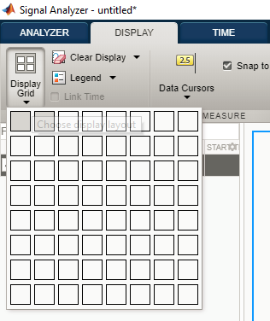
View Signals on Multiple Plots

Slide 14
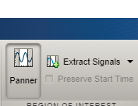
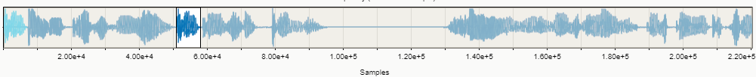
Panner

Slide 15
Conclusion
tool to analyze a signal by easy way.
perform different operation on signal without coding.
compare different signals by easy manner .

